Slide 1

HLgoe Social Media Strategy
[Your name]
[Your title], [Your team]
[email address]

Slide 2
Instruction Slide: Delete Me
How to use this template
Note: Slides with a “delete me” note, like this one,
are instructions to help you customize the template.
Before you share your strategy with stakeholders, remember to remove these slides from the presentation.
Once you’ve followed the advice in our social media strategy guide, you’re ready to use this template.
To fill it out, you need to make your own copy. To do that, click the File tab in the upper left hand corner of your browser.
Then select Make a copy
Now you have your own version!

Slide 3

Executive Summary

Slide 4

Instruction Slide: Delete Me
Writing an effective executive summary
The summary should contain
the following information:
Identify the problem or need for a social media strategy or proposed campaign
Explain the anticipated result(s)
Lay out the budget, time, and resources required to execute
Include any additional information worth noting
The executive summary is a synopsis of your social media marketing plan. It should not exceed one page.

Slide 5
Executive Summary
[ PROBLEM / What problems are we facing as a business that social media can help address? (i.e., brand awareness, customer service, reputation, etc.]
[ RESULTS / What could we potentially achieve by implementing this strategy?]
[ BUDGET/ RESOURCES / What will be required in terms of time and money to implement this strategy?]
[ TIMELINE / When will we implement it? ]

Slide 6
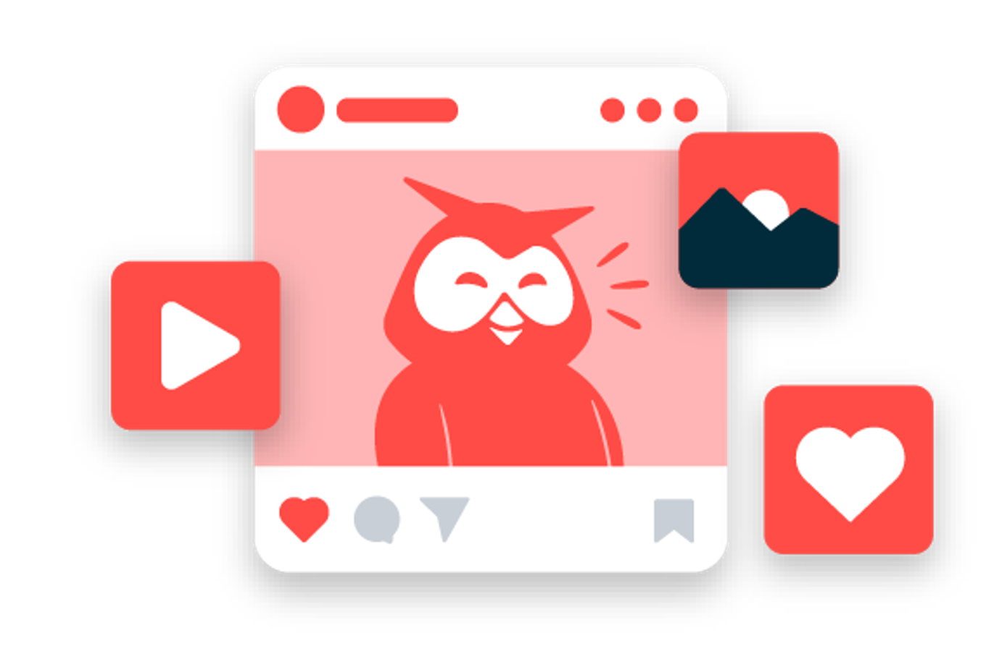


Social Media Goals

Slide 7
Instruction Slide: Delete Me
Setting Smart Goals
1
2
3
Set goals that are specific, measurable, attainable, relevant, and timely
Related resource: How to Set and Exceed Social Media Goals
Make sure they are aligned to business objectives to accurately measure return on investment
Related resource: A Step-by-Step Guide to Proving Social Media ROI
Make sure they are aligned to business objectives to accurately measure return on investment
Track the right metrics to stay focused on what matters
Related resource: The Social Media Metrics That Really Matter (And How to Track Them)
The objective, goals, and metrics you’ll see further down in this template are examples.
Update with what works for your business.

Slide 8
How your social goals align to your business goals
Our business goals | Our goals on social | Our metrics
Help potential customers find us | Awareness (these metrics illuminate your current and potential audience) | Reach, impressions, follower growth, shares, etc.
Convince people to choose us | Engagement (these metrics show how audiences are interacting with you) | Comments, likes, @mentions, etc.
Sell the product! | Conversions (these metrics demonstrate the effectiveness of your social engagement) | Website clicks, email signups, sales, etc.
Keep customers happy and earn their loyalty | Consumer Sentiment (these metrics reflect how active customers think and feel about your brand) | Testimonials, social media sentiment, average response time (for social customer service/support) etc.

Slide 9
Social Media Goals
By [date], we will:
1
[Insert S.M.A.R.T goal here — eg. “We will grow our Instagram audience by 50 new followers per week.”]
3
[Insert S.M.A.R.T goal here — eg. “We will grow our Instagram audience by 50 new followers per week.”]
2
[Insert S.M.A.R.T goal here — eg. “We will grow our Instagram audience by 50 new followers per week.”]
4
[Insert S.M.A.R.T goal here — eg. “We will grow our Instagram audience by 50 new followers per week.”]

Slide 10


Target Audience

Slide 11
Instruction Slide: Delete Me
Defining your audience
Use the next slide to clearly and succinctly define who your target audience/customer/buyer persona(s) is.
Related resource: How To Build a Buyer Persona (Includes a Free Template)
Knowing who your audience is and what they want to see is key to creating content that they will like, comment on, and share. It’s also critical for planning how to turn followers into customers.

Slide 12
[Persona name #1]
[Persona name #2]
[Persona name #3]
Example job title(s) | [What sort of job titles does this person have?]
Demographics | [i.e., Country, age range, relationship or family life stage, etc.]
Preferred social network(s) | [What social media platform does this person use most often, i.e. where is the best place to connect with them?]
Brand affinities | [Which brands do they already interact with or admire on social media?]
Budget (for your product/service) | [What do we know about how much they are willing or able to spend in our category?]
Goals/aspirations | [What do they aim for in life, and how do we product support them?]
Pain point(s) | [What is their biggest challenge or struggle?]
How we help | [How does our product solve their challenge?]

Slide 13

Competitive Analysis

Slide 14
Instruction Slide: Delete Me
Conducting a Competitive Analysis
Use the next slide to create a high-level overview of your competitors’ plan. Then conduct a SWOT analysis (strengths, weakness, opportunities, threats) for your own brand using slide no. 16
Related resource: How to Conduct a Competitive Analysis on Social Media (Free Template Included)
Analyze the competition’s social media presence. This will help inform your own social strategy. If you know what your competitors are doing well—and not so well—you’ll discover where you might have a competitive edge.
Or, if you’re asking your boss to invest more in social media, showing your leaders where your peers and competitors are succeeding can help with that too.

Slide 15
 | Networks active | Number of followers | Strengths | Weaknesses | Content that resonates
[Competitor # 1] | [eg., Facebook, TikTok, etc.] | [eg., 15,000] | [What do people like about their presence? What do you wish you had thought of first?] | [Which features do they use or not use? What are their engagement rates like? What do you think of their tone and quality?] | [Which posts have seen unusual success?]
[Competitor # 2]
[Competitor # 3]

Slide 16
Swot Analysis
 | Positive | Negative
 | Strengths | Weaknesses
Internal | What are your strengths? Eg. “Video production and expertise” etc. | What are your brand’s weakness on social media? Eg. “Low X (Twitter) engagement” etc.
 | Opportunities | Threats
External | What/where are the opportunities for your business on social media? Eg. “Competitors aren’t using Instagram Stories” etc. | What are your brand’s threats? Eg. “Competitor Y has 2x our social share of voice” etc.

Slide 17





Hootsuite helps you CRUSH your social goals
Create, schedule, and publish
to all your profiles from one place
Pardon our shameless plug…
See what’s working with analytics and reports
…But Hootsuite is exactly what you need to manage your entire social media strategy from one easy-to-use tool.
Monitor what people are saying about your brand
Respond to messages and comments from a single inbox
TRY IT FOR FREE

Slide 18

Social Media Audit

Slide 19
Instruction Slide: Delete Me
Auditing your social media presence
If you’re already using social media,
take a step back and look at:
What’s working and what’s not
Who is engaging with you
Which networks your target audience is most active on
How your strategy compares to the competition and/or your peers
Use our step-by-step guide to conducting a social media audit (+ spreadsheet template) to get this done quickly and stay organized.

Slide 20
Social Media Benchmarks
As of: [date]
CHANNEL | Number of followers | # of Posts | Average engagement Rate | Click-through rate | Mentions | Reach
Instagram
Facebook
X (Twitter)
LinkedIn
Pinterest

Slide 21
Social Media Audit
[Network #1] | [Network #2]
What’s working: | What’s working:
What’s not working: | What’s not working:
Audience: | Audience:
Lessons / hypotheses: | Lessons / hypotheses:

Slide 22
Action Items
To Do: | When:
[eg., Deprecate X (Twitter) account, or Request budget for freelance video editor] | [end of June]

Slide 23

Content Strategy

Slide 24
Instruction Slide: Delete Me
Crafting your content strategy
Determine your content mix and posting cadence on the next two slides.
You can start by using the social media content rule of thirds:
⅓ of content promotes business and converts audience
⅓ of content shares / curates ideas and stories from other accounts
⅓ is original content
Related resource: Content Idea Cheat Sheet
Download our editorial calendar template and social media content calendar template (link below) to assist your planning.
Related resource: Social Media Templates to Save You Hours of Work

Slide 25
Content Pillars
[Content Pillar #1 eg., Entertaining/Informative] | [Content Pillar #2 eg., Branded/Promo/Sales] | [Content Pillar #3 eg., Company Culture/Values]
offers education or entertainment doesn’t ask for anything back can be curated or shared from other accounts | specific to our offering benefits and features promotions and sales | who are we, and what do we stand for? connect with customers on a deeper emotional level
Post ideas [eg., Instagram Story featuring existing customers (a.k.a. user-generated content or UGC)] | Post ideas [eg., Black Friday sale] | Post ideas [eg., volunteer stories from fun run]
Frequency | Frequency | Frequency

Slide 26
Resources
Editorial Calendar
Social Media Content Calendar
Content Library
[Add Link -- this maps out content release schedule for blog posts, campaigns, product launches—anything that will impact what we post on social]
[Add Link — this maps out actual individual posts for each social network, along with visuals, links, copy, etc.]
[Add Link — this is where we store all videos, photos, templates, infographics, brand assets, style and voice guidelines, including the content we’ve already used and the content we might want to use in the future]

Slide 27

Next Steps

Slide 28

Instruction Slide: Delete Me
Measuring Your Progress
Use analytics tools to measure how you’re performing against the goals, business objectives, and metrics you set earlier.
Related resource: The Best Social Media Analytics Tools (+ Free Social Media Report Template)
Once you compiled data, create slides highlighting key learnings and next steps.

Slide 29
Progress Update
Date Range
CHANNEL | Net Followers Gain/Loss | # of Posts | Engagement Rate | Click-throughs | Mentions | Reach
Instagram
Facebook
X (Twitter)
LinkedIn
Pinterest

Slide 30
What should we continue doing?
[Social network] | [Social network]
What’s working: | What’s working:
Why is it working: | Why is it working:
Action Items: | Action Items:

Slide 31
What should we stop doing?
[Social network] | [Social network]
What’s working: | What’s working:
Why is it working: | Why is it working:
Action Items: | Action Items:

Slide 32
What should we start doing?
[Social network] | [Social network]
What’s working: | What’s working:
Why is it working: | Why is it working:
Action Items: | Action Items:

Slide 33

Thank you

